Slide 1
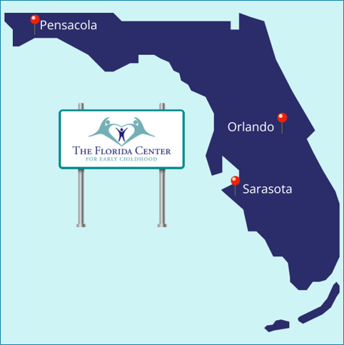

From Strategy to Action
Florida FASD State Task Force
Quarterly Meeting – April 23, 2026

Slide 2
Review of Past 6 Months
Respect Act passed – federal recognition of FASD
Florida landscape work completed – we know the gaps
We have momentum. Now we need to act.

Slide 3
The Challenge We’re Solving
Original strategic plan was vision-heavy but hard to execute
Too many strategies, not enough owned action steps
We need to focus and simplify so we can actually move forward

Slide 4
Our New Approach
Rule of 3: 3 priorities at a time
Quarterly sprints instead of multi-year strategies
Every action has an owner, a deadline, and a clear deliverable
Two-layer model: Core Leadership (doers) + Task Force Network (amplifiers)
Yearly Calendar with intentionally focused conversations within the task force

Slide 5
Two-Layer Model
Core Leadership
Task Force Network
Provide connections
Open doors
Complete micro-actions
Meet quarterly
Own outcomes
Drive execution
Meet monthly
Both layers are essential

Slide 6
Calendar Going Forward
January
April
July
October
Strategic Plan Micro Goals
Strategic Plan Micro Goals
FASD Awareness (micro goals to spread awareness)
Year in Review (where we are & where to focus)

Slide 7
Priority 1: Awareness & Professional Education
Annual Outcome: Reach 300+ professionals through FASD education
Q2 Goal: Increase outreach efforts (emails) and new locations
Key Actions:
Create wording to promote
Send out flyer
Outreach to new locations
Determine realistic goals

Slide 8
Priority 2: Screening (Pilot)
Annual Outcome: Launch 1–2 pilot programs integrating FASD screening
Q2 Goal: Create an Implementation Guide for Home Visitors
Key Actions:
Create implementation guide
Recruit members to participate in 1-time focus group
Review implementation guide

Slide 9
Priority 3: Policy & Legislative Engagement
Annual Outcome: Engage 3–5 state-level champions for FASD
Q2 Goal: Meet with 2 FL Senators, Identify FASD Champions (1 House / 1 Senate)
Key Actions:
Identify targets
Schedule meetings
Identify champions to assist in the meetings

Slide 10
How YOU Can Help Today
You don’t need to join a workgroup. You just need to open one door.
Awareness
Screening
Policy
Who knows a person or organization that might benefit from learning about FASD?
Who has contacts at Early Steps, child welfare, Healthy Start to join a 1-time focus group?
Who has a relationship with a legislator or agency leader?

Slide 11
Micro-Commitments
Make 1 introduction
Send 1 email
Share 1 contact
Attend or support 1 meeting
“Small actions create big momentum”

Slide 12
Progress Dashboard
Priority Area | Q2 Goal | Status | Lead
Awareness & Professional Education | Increase outreach efforts and new locations
Screening (Pilot) | Create Implementation Guide for Home Visitors
Policy & Legislative Engagement | Meet with 2 FL Senators, Identify FASD Champions
(To be filled in live or after discussion)

Slide 13
What’s in the Parking Lot (Not This Year)
Statewide FASD conference
Statewide recurring diagnostic clinic funding
Governor’s Council
Public media campaign
These matter – but we’re focusing on what we can accomplish NOW

Slide 14
What Happens Next
Core leadership meets monthly to drive execution
Full task force meets quarterly to activate network
Progress reported at every meeting – visible and accountable
Non-attendees get follow-up with specific asks

Slide 15
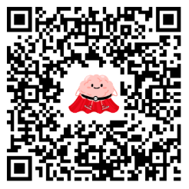

Slide 16
“Next time we meet, we will report on THESE outcomes and discuss the new goals.”
Thank You
Next Meeting
Thursday, July 23, 2026
9 AM to 10 AM EST

